Slide 1
>How Something Old
Can Make DNN New Again
David Poindexter
nvisionative, Inc. / Mobile Applify
@davidpoindexter / @nvisionative / @mobileapplify

Slide 2
>How Something Old
Can Make DNN New Again

Slide 3
About Him
Kelly Ford
DNN Developer since v.1
Cloud Consulting/Developer (AWS)
Design and Develop DNN Sites/Apps
Host DNN Sites
Lazy — but in a good way
Hi!

Slide 4
Founder, Head Know-It-All
KnowBetter.com
Founder, Webmaster
DNNDev.com
Creator, Lead-Dev Best-Selling Module Since 2004

Slide 5
About Me
David Poindexter
DNN Developer since v.1
Design and Develop Web/Mobile Solutions
Creative Marketer
Branding Expert
Lazy — but in a good way
Hi!

Slide 6
CEO (aka, GeekEO)
nvisionative, Inc.
Founder, Lead Dev
Mobile Applify
Vice President, DNN Association Organizer of DNN Summit
Co-President, Southern Fried DNN Monthly Meetups

Slide 7
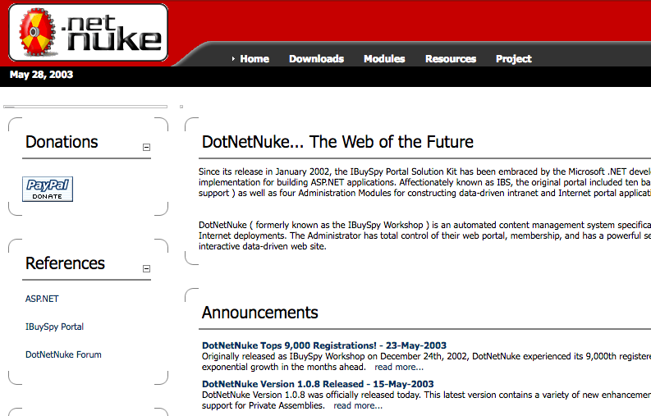
DNN Has Evolved
2003
2017
DotNetNuke Tops
9,000 Registrations!
Fortune 500
Companies Galore
Notes:
In 2003, WebForms and all its PostBack glory was the new hotness. Today, WebForms are being supplanted by Single Page Applications that leverage WebAPI and communicate via JSON and that don’t cause page postbacks.

Slide 8
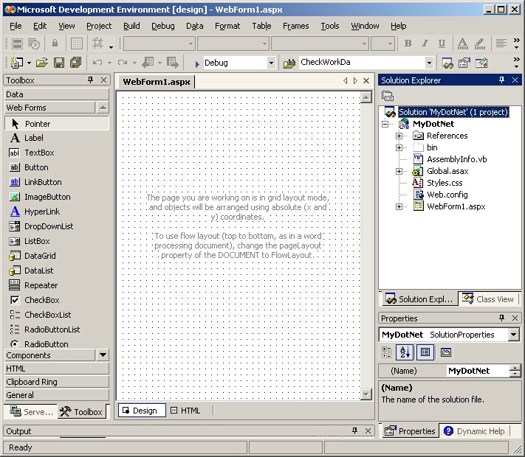
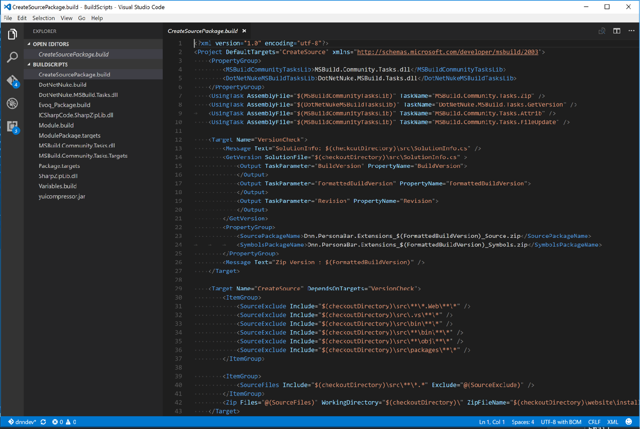
Editors Have Evolved
2003
2017
Drag N’ Drop Mayhem Windows Only
Fast, Efficient Coding Cross-Platform
Notes:
Because the web has evolved, editors have had to change. Instead of dragging and dropping graphical controls onto a canvas (with Visual Studio 2013), we are coding our interfaces in text, with HTML, CSS, and Javascript (with Visual Studio Code, or WebStorm or Sublime Text or even Vim).

Slide 9
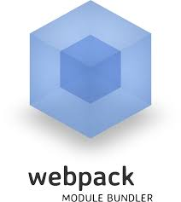
Front End Tooling…
Exists
Notes:
Creating applications using client-side scripting is complicated. Thankfully, we’ve gone from Zero to an environment where a new tool seems to pop-up every day.

Slide 10
Even .NET is Changing
Nuget
Powershell
Cross-Platform with .NET Core
Windows Gets Bash

Slide 11
One Thing Is Clear
>
The humble command line is cool again
But Why?

Slide 12
GUI’s Make Us Grumpy

Slide 13
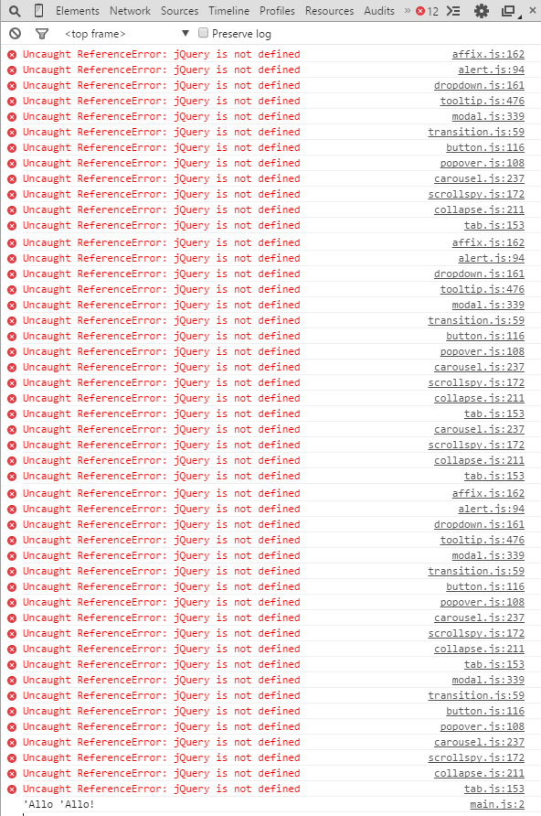
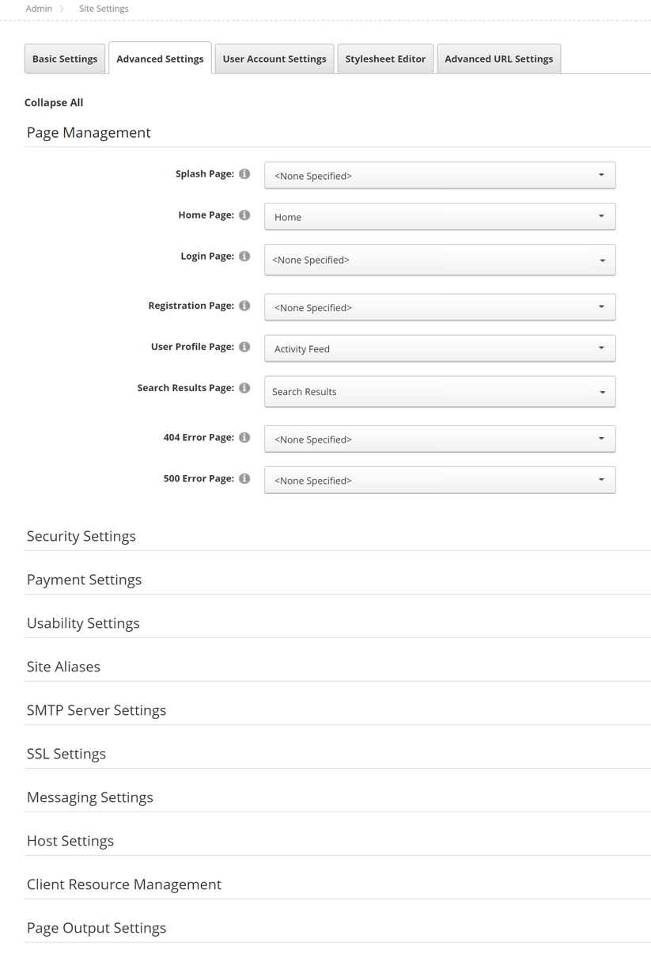
Bad GUI
Cumbersome for Option-Rich Actions
Fragile — Errant CSS/JS can break them
Complicated to Modify
On the Web They’re Slow…
Notes:
GUI’s can be great, don’t get me wrong, but they’re not ideal for everything…

Slide 14
Improving the GUI
DNN 9’s Persona Bar
AJAX = No Page Reloads
Reduce Options
GUI Improvements Can Only Take You So Far
Still Slow — Lots of Clicking
Confusing: Most Users Don’t Need All Options

Slide 15
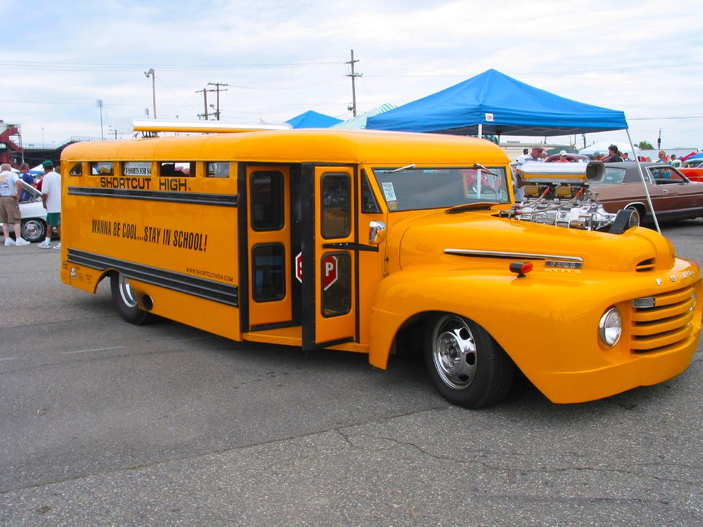
It’s Time DNN Goes
OlD Skool

Slide 16
Introducing Prompt
>
The Command Line for DNN
Command Line Interfaces (CLI)
A CLI is used whenever a large vocabulary of commands or queries, coupled with a wide (or arbitrary) range of options, can be entered more rapidly as text than with a pure GUI
Wikipedia

Slide 17
Command Lines Are:
Awesome
Intimidating
Prompt Brings the Awesome
And the Friendly

Slide 18
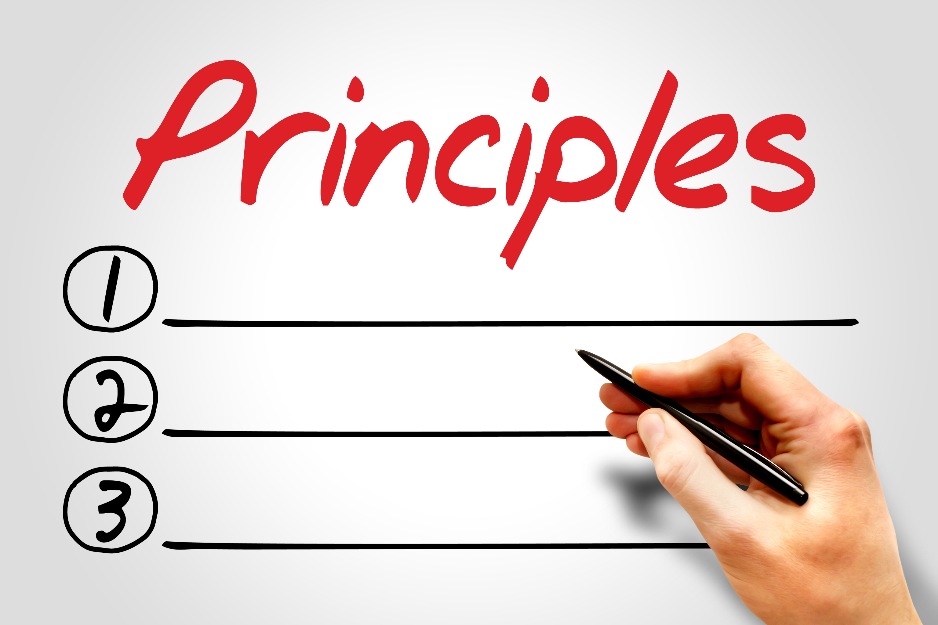
Design
Feel and operate like a CLI
Reduce Intimidation
Mnmze Keystrokes
Minimize Keystrokes
Notes:
• Feel and operate like a Command Line - with the same efficiency and speed. However, I don’t want to leverage HTML when needed to improve efficiency or UX
• Reduce the intimidation factor
▪ Extensive help, with examples,
▪ Suggestions
▪ Meaningful error messages
▪ Consistent naming (add vs new)
▪ Case insensitivity
• Reduce keystrokes when possible
▪ Instead of 'create', prompt uses 'new' (1/2 the characters)
▪ If you are passing a string value for an option, you only have to enclose it in quotes if it is more than one word or contains characters that cause incorrect parsing.

Slide 19
Demo

Slide 20
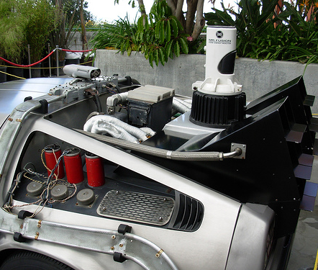
Back to the Future of DNN
(Insert Groan Here)
Notes:
… but seriously, let’s look at how the Prompt command line can benefit the platform now and into the future.

Slide 21
DNN Platform Benefits
Now
Future
Efficient Administration
Simplifies the UI
Easy Extensibility
Unique Among CMS’s
Faster Rollout
Site Scripting
Ecosystem Growth
“npm” for Extensions
> dnnpm —install xmodpro
Notes:
** Efficient Administration: The demo kind of showed that
** Simplifies the UI: By moving less-common settings to the command line, DNN can simplify the Platform’s user-interface, making it easier for new users to comprehend while reducing the visual weight of the UI.
** Easy Extensibility: This is a key feature of Prompt. I’ll talk more about it in a second.
** Unique Among CMS’s: I’m not aware of any major CMS that includes a command line. As I understand it, Django has a command line but it runs from the OS. Prompt runs within DNN, making it accessible to users who don’t have server access. Regardless, developers are flocking to the CLI and having a built-in CLI will differentiate DNN from the crowd, hopefully attracting more devs.
———
** Faster Rollout: Because Prompt handles the UI, all a command has to do is receive JSON and return JSON. No UI has to be built. Further, Commands are encapsulated - designed to do one thing. This makes it easier to minimize coupling and makes testing easier, resulting in more stability and greater confidence on the part of developers.
** Site Scripting: You can create a command that performs a series of activities like setting up a list of new users or performing security checks or any process a business may want to perform regularly.
** Ecosystem Growth: Prompt’s easy extensibility and name spacing opens up a brand new avenue for developers. Module developers can offer Prompt commands to administer their modules. Custom commands can be easily built and deployed by IT departments that interact with backend systems. You could even setup integration with external web services.
** “npm”: Imagine being able to install a module or any extension from the command line. No need to download. <CLICK> Simply type `dnnpm —install xmodpro` and it fetches and installs it for you just like ‘npm’ or Ubuntu’s ‘apt-get’. This could also be used to update the module. <CLICK> This is such a cool idea that I’ve already begun work on it.

Slide 22
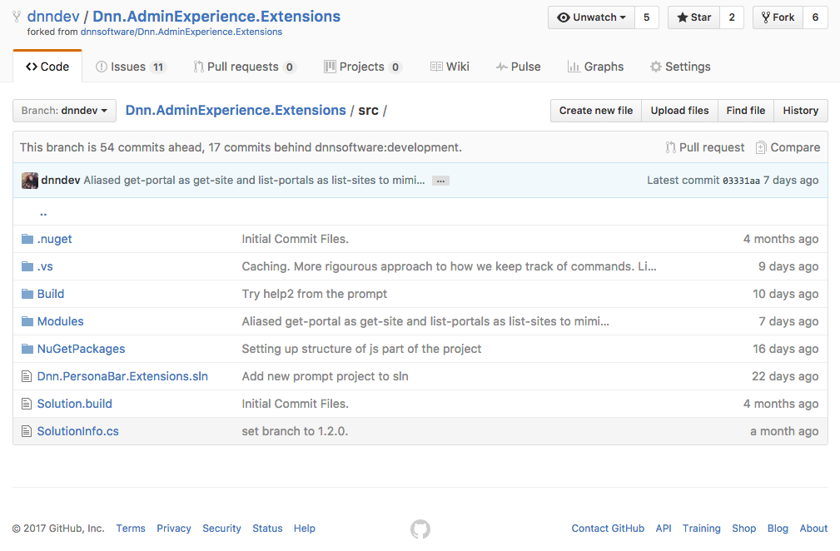
Contribute
http://xmp.cc/PromptGitHub
Submit Bug Reports
Pull Requests
Test Security
Submit Suggestions

Slide 23
Questions?

@dnndev

kford@dnndev.com

dnndev
Prompt Wiki: http://xmp.cc/PromptWiki
Shout Out to Prompt Contributors:
Peter Donker
David Poindexter
Clint Patterson
Chris Hammond
Brian Dukes
Notes:
Check out the Wiki Clint Patterson created http://xmp.cc/PromptWiki

Slide 24
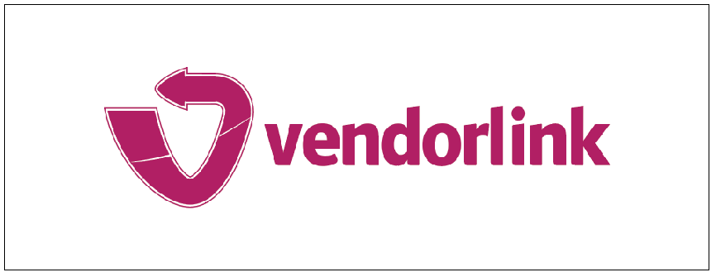
Please support our valuable sponsors

